Slide 1

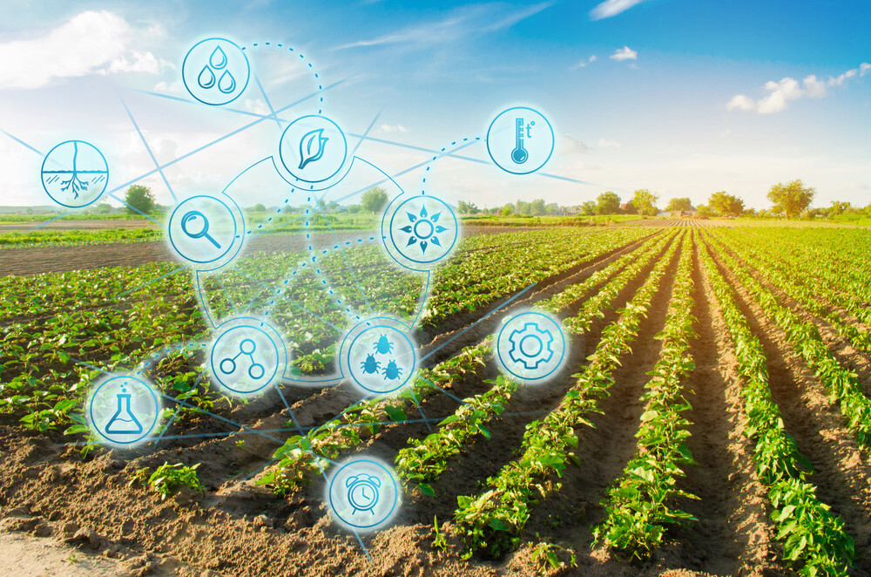

Agropanda
(Farmers platform)
Project id – 2021_135
28/04/2021

Slide 2
Overall Project Description
Research Problem
Research Objectives
Overall solution
28/04/2021

Slide 3
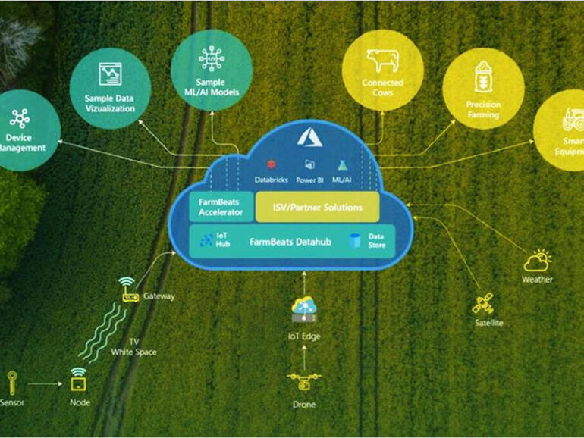
System Overall Diagram
28/04/2021

Slide 4
IT16037984 | R. Jayaraman
B.Sc (Hons) in IT
28/04/2021

Slide 5
Research Questions
RQ1- Which machine learning algorithms have been used in the literature for crop yield prediction?
RQ2- Which features have been used in literature for crop yield prediction using machine learning?
RQ3- Which evaluation parameters and evaluation approaches have been used in literature for crop yield prediction?
RQ4- What are challenges in the field of crop yield prediction using machine learning?
28/04/2021

Slide 6
Objectives
Specific Objective
Sub Objectives
Creating a platform for farmers
Suggesting suitable crop
Price prediction
Suggesting pesticides
Chatbot for user requirements
28/04/2021

Slide 7
Methodology
Artificial neural network
Logistic regression
Python
Android
28/04/2021

Slide 8
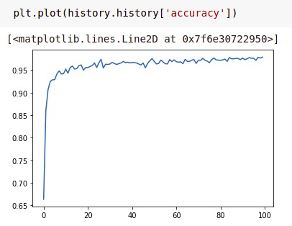
Testing and Results
28/04/2021

Slide 9
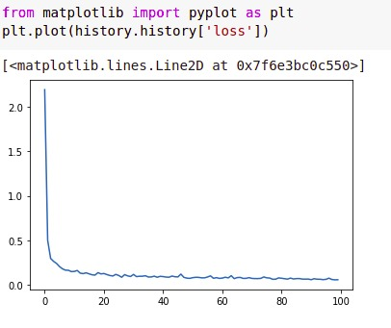
Testing and Results cont..
28/04/2021

Slide 10
IT18186048| Anjanan
B.Sc (Hons) in IT
28/04/2021

Slide 11
Multivariate prices analysis and prediction of vegetables of Sri Lankan Markets.
28/04/2021

Slide 12
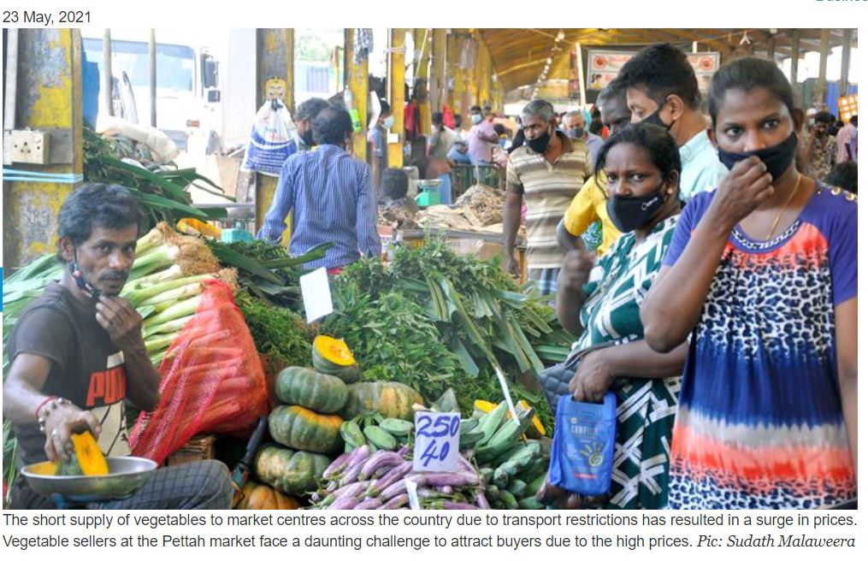

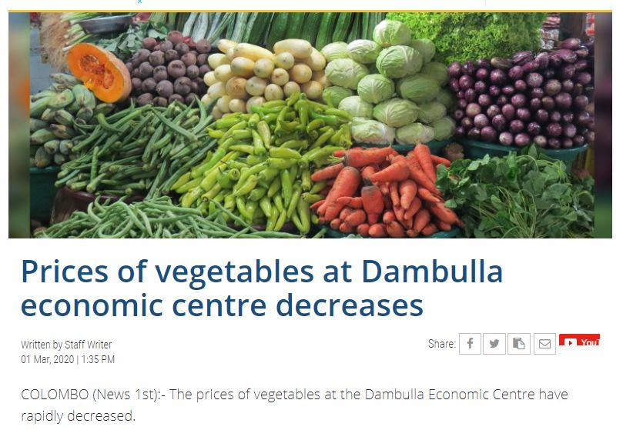
28/04/2021

Slide 13
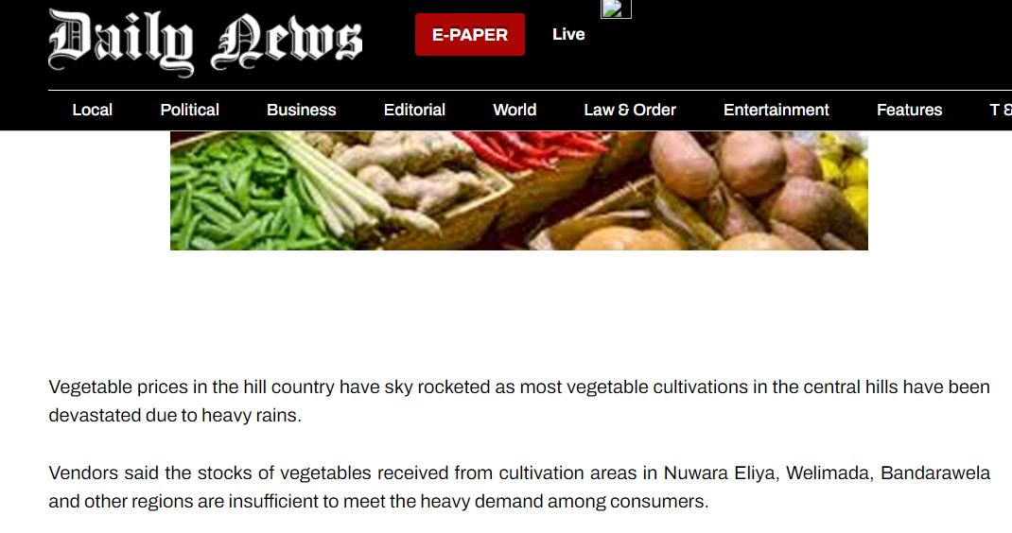
28/04/2021

Slide 14
Research question
1. What are the factors which could affect the price of a vegetable in a market in Srilanka.?
1.2. Does price of vegetable in one market contribute to another market
28/04/2021

Slide 15
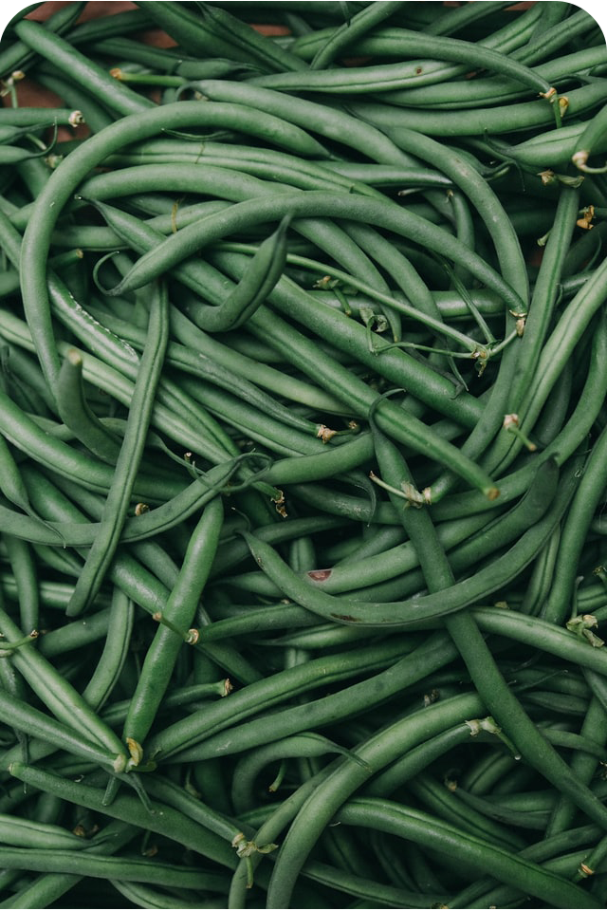
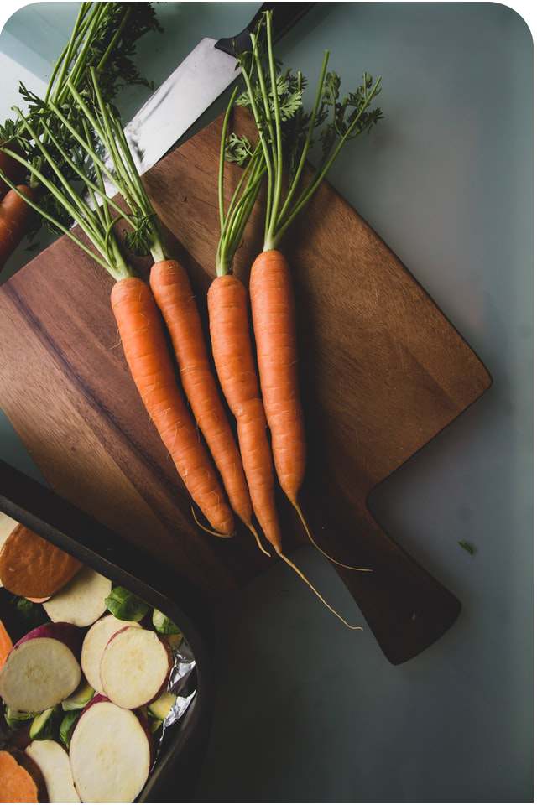
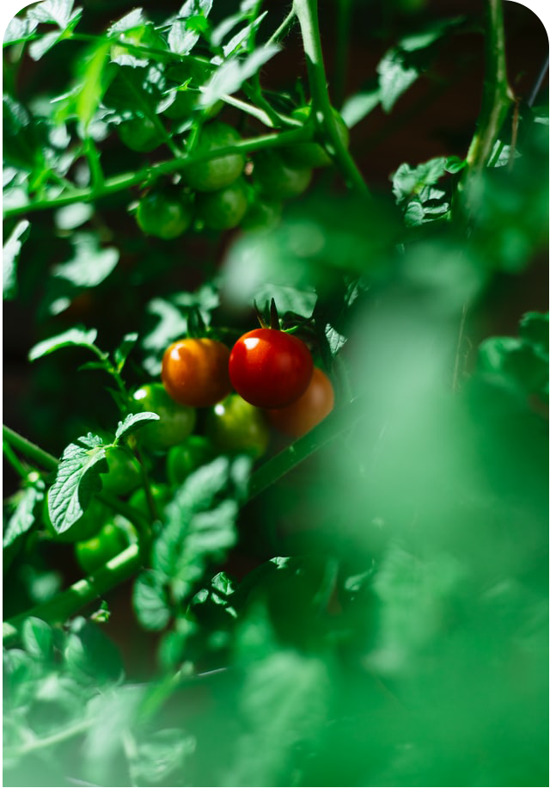
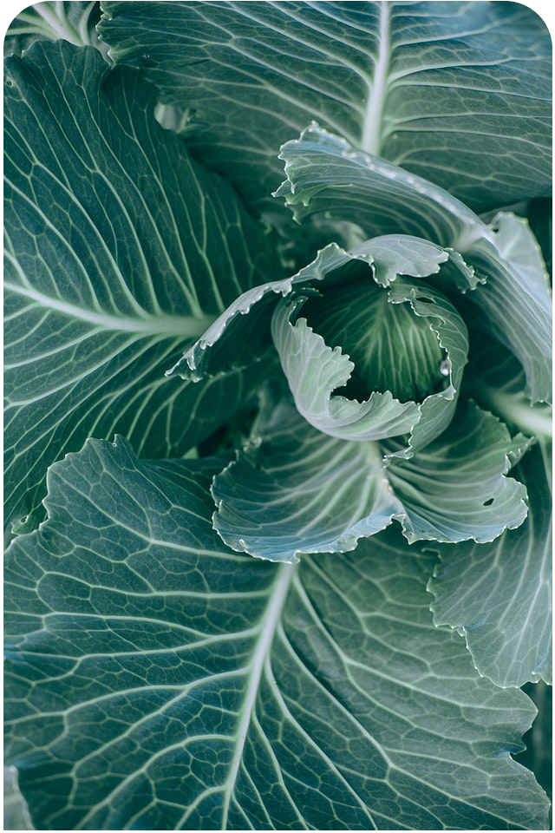
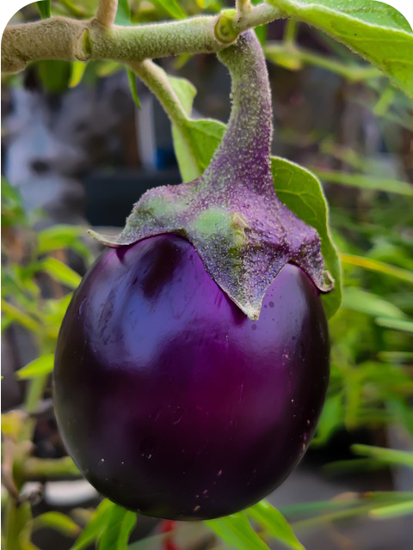
Bean
Carrot
Tomato
Cabbage
Brinjal
28/04/2021

Slide 16
Bush beans can be harvested a little faster than pole beans. They mature in 50 to 55 days, while pole beans will take 50 to 60 days. On average, it takes bean plants a little less than two months to produce beans and fully mature, but different cultivars have different maturities
Early-season tomatoes require 50 to 60 days to reach harvest from transplanting;
Carrots should be ready for harvest about 60-80 days after sowing seeds
Brinjal can begin harvesting about 75 days after transplanting
Days to maturity is around 70 days for most green cabbage varieties and most produce 1- to 3-pound heads.
28/04/2021

Slide 17
Main Objective
Produce a multivariate forecasting model which performs better analysis and forecast for Sri Lankan market.
28/04/2021

Slide 18
Models used
Produce a multivariate forecasting model which performs better analysis and forecast for Sri Lankan market.
Statistical Method
VAR
Deep Learning
LSTM
28/04/2021

Slide 19
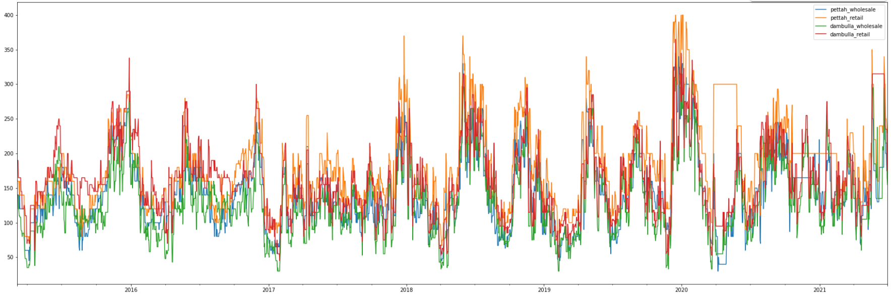
Type of forecasting.
The causes for these price fluctuations can be divided into two categories as endogenous (changes in supply and demand within the sector) and exogenous (changes take place outside the economic environment) causes
Variants considered in this research is retail and wholesale price in Pettah and Damubulla for a vegetable.
28/04/2021

Slide 20
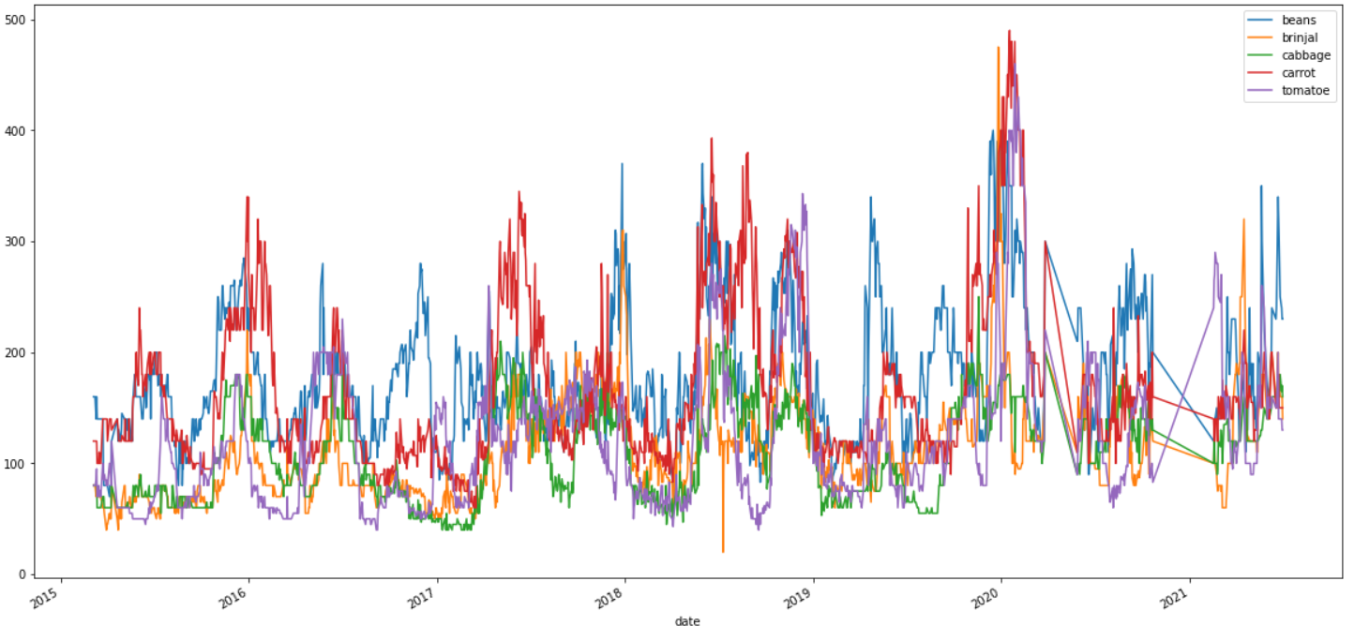
Data used for analysis:
Daily data from March 2015 to June 2021
Dambula
Pettah
28/04/2021

Slide 21
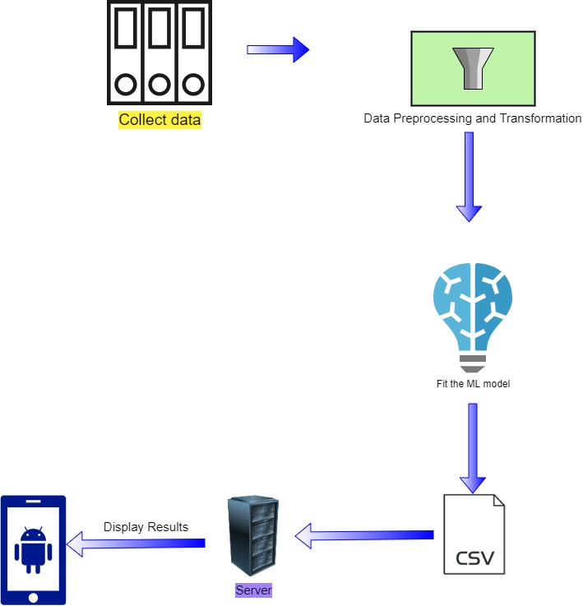
Over View
28/04/2021

Slide 22
Results
Vegetable Type | Metric | LSTM | VAR
Beans | MAE | 30 | 43
 | MSE | 1867 | 3059
Carrot | MAE | 36 | 32
 | MSE | 2509 | 1631
Cabbage | MAE | 18 | 25
 | MSE | 718 | 986
Tomato | MAE | 24 | 40
 | MSE | 1608 | 2642
Brinjal | MAE | 37 | 52
 | MSE | 2817 | 2428
Average | MAE MSE | 29 1903 | 40 2149
LSTM is taken as the model to forecast as it has less error totally, although carrot showed less error in VAR.
28/04/2021

Slide 23
90 days forecasting is presented to mobile solution using Django server at last
28/04/2021

Slide 24
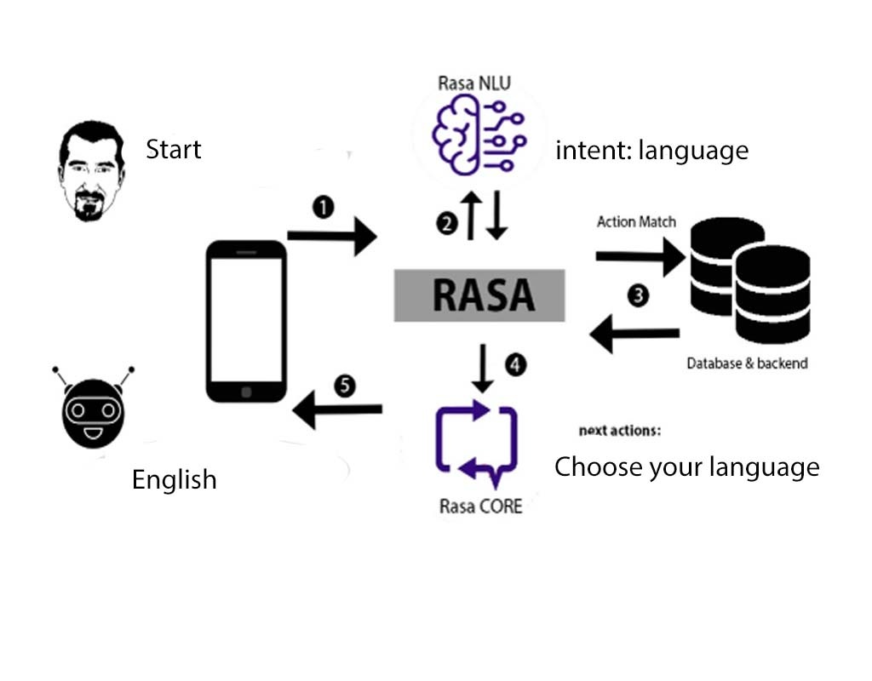
Methodology
28/04/2021

Slide 25
IT18181784 LATHUSHA SRITHARAN
B.Sc (Hons) in IT
IT18181784 | S. LATHUSHA | 2021-135
14/10/2021

Slide 26
Research Questions
How will the system help to new comers to faming field in Sri Lanka?
How can a new farmer identify diseases in the plants ?
What are the main plant diseases damaging the cultivation in Sri Lanka?
What are the pesticides using to cure the plant diseases in Sri Lanka?
How to use pesticide to affected plant?
How to protect other plants from affected plants ?
How can we give the most accurate result to users?
IT18181784 | S. LATHUSHA | 2021-135
28/04/2021

Slide 27
Research Gap
There are several type of researches to identify the diseases and Leaves of crop by using image processing but this system is using both image processing and deep learning.
Most of researches focus other country agriculture methods. But our systems only focuses in Sri Lanka Agriculture.
The classification and image recognition of disease are major technical and economic importance in the agricultural industry
Most of the researchers identity the diseases , but they don’t give the solution . Some researchers try to suggest pesticide, but users don’t know how to use pesticides. This system will suggest pesticides and how to use the pesticides and management.
IT18181784 | S. LATHUSHA | 2021-135
28/04/2021

Slide 28
Objectives and sub Objectives
Main Objective
The primary goal of this project is to improve the livelihood of vegetable plants by identifying specific disease in early stages
recommending organic and inorganic pesticides, fertilizer for the diseases, and acquiring efficiency in the use of fertilizers and pesticides
Sub Objectives
Identify plant affected by pest diseases or not.
Identify a method to increase the efficiency of using pesticide or insecticide
Taking photo of that affected area.
Finding disease using image processing
Suggest the pesticide and managements
IT18181784 | S. LATHUSHA | 2021-135
28/04/2021

Slide 29
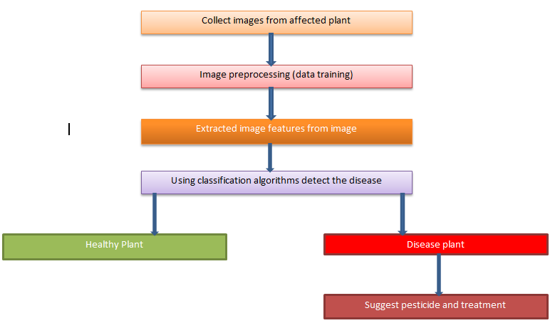
Methodology
IT18181784 | S. LATHUSHA | 2021-135
28/04/2021

Slide 30
Data collection
I went to Agriculture department of Jaffna. I discussed with the officers. They gave me to books to collect data such as images, diseases names, pesticides, method of use pesticides and cultural methods.
Pest Management Recommendation from Ministry of Agriculture, Department of Agriculture
Pest Management Decision Guide from Permanent Crop Clinic Programme Sri Lanka.
IT18181784 | S. LATHUSHA | 2021-135
28/04/2021

Slide 31
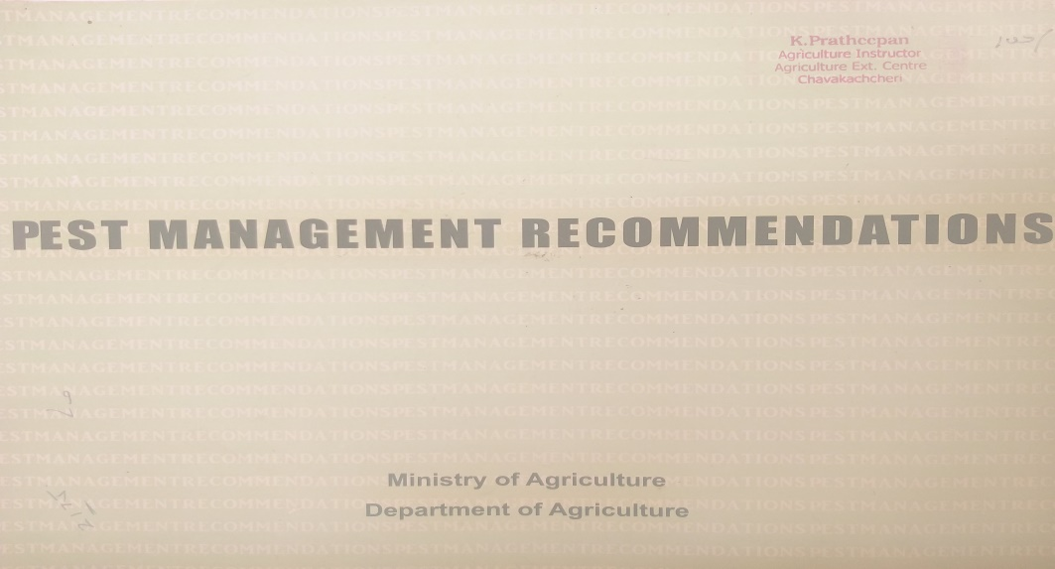
IT18181784 | S. LATHUSHA | 2021-135
28/04/2021

Slide 32
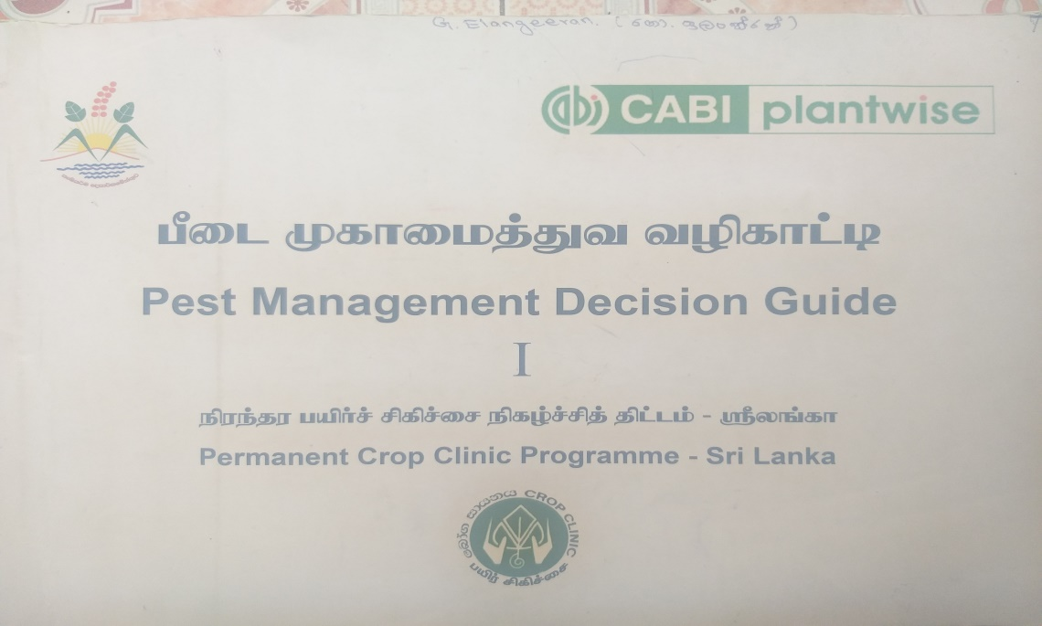
IT18181784 | S. LATHUSHA | 2021-135
28/04/2021

Slide 33
Diseases Images Collection
Most of the images I collected from kaggle and internet.
And also I visited to farming field to collect needed images
IT18181784 | S. LATHUSHA | 2021-135
28/04/2021

Slide 34
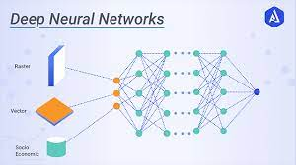


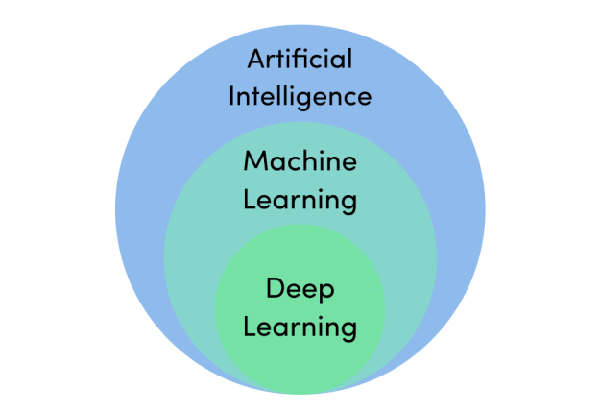


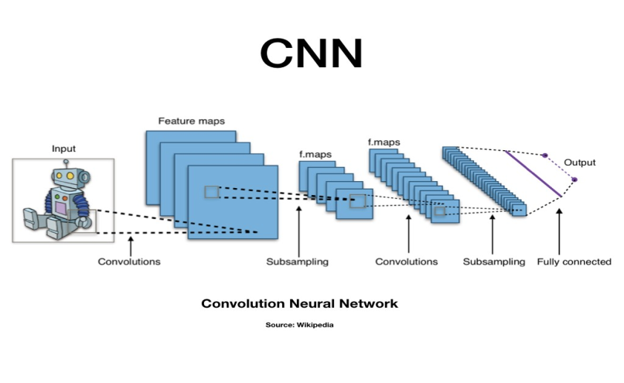

Key Pillars and Technologies
Technologies
Key Pillars
Technologies
Key Pillars
IT18181784 | S. LATHUSHA | 2021-135
28/04/2021

Slide 35
Research Questions
Farmers unable to expand their marketing. They can cover a small area. What is the basic problem?
How do you choose a user-friendly platform for farmers?
What are the outputs farmers are expecting?
How to use vegetables name with different language people while marketing?
IT18181784 | S. LATHUSHA | 2021-135
28/04/2021

Slide 36
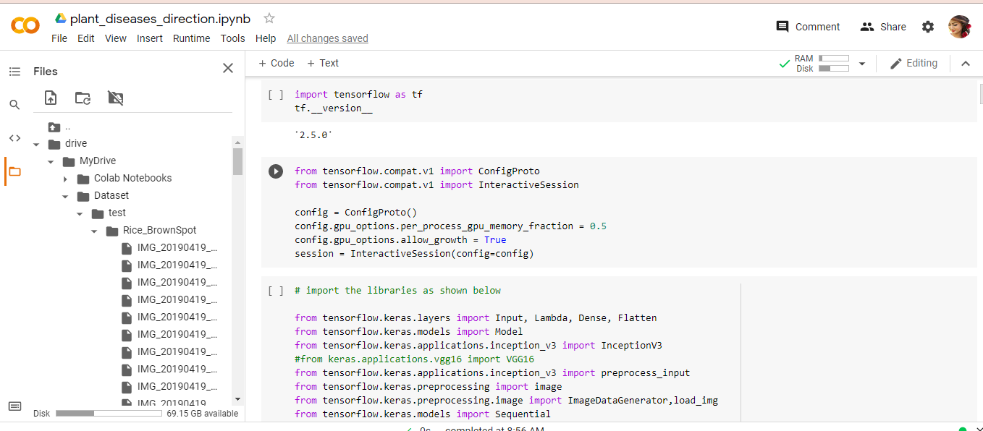
Achievements
Data Training method
IT18181784 | S. LATHUSHA | 2021-135
28/04/2021

Slide 37
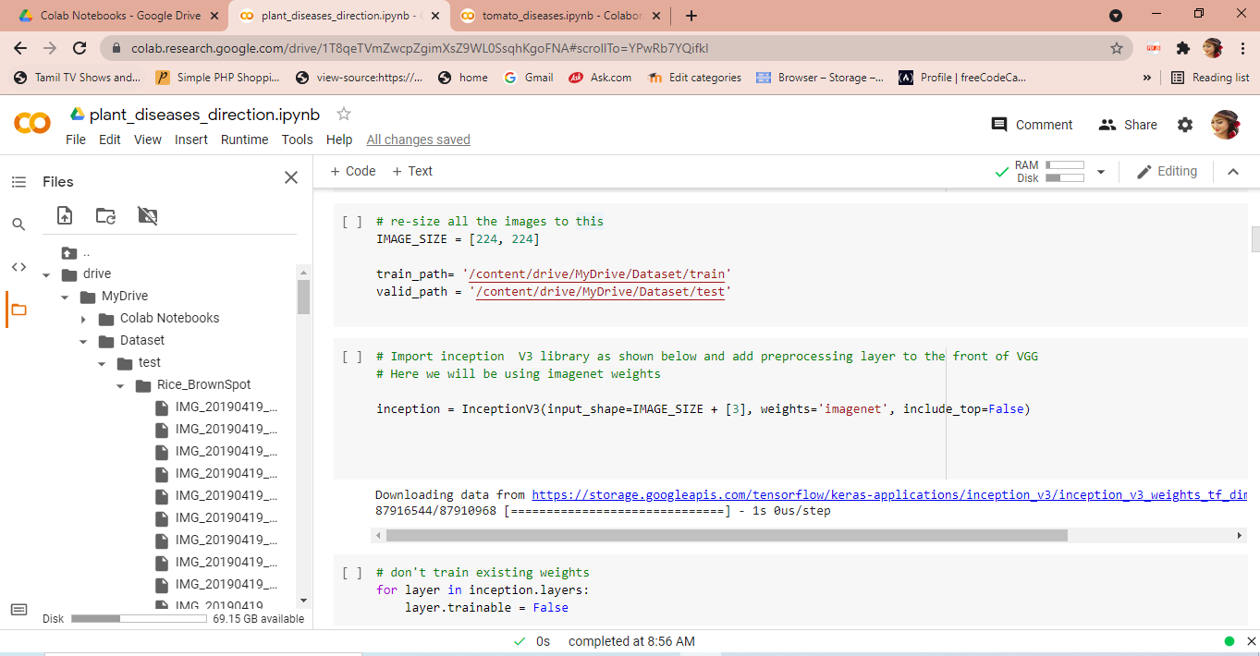
IT18181784 | S. LATHUSHA | 2021-135
28/04/2021

Slide 38
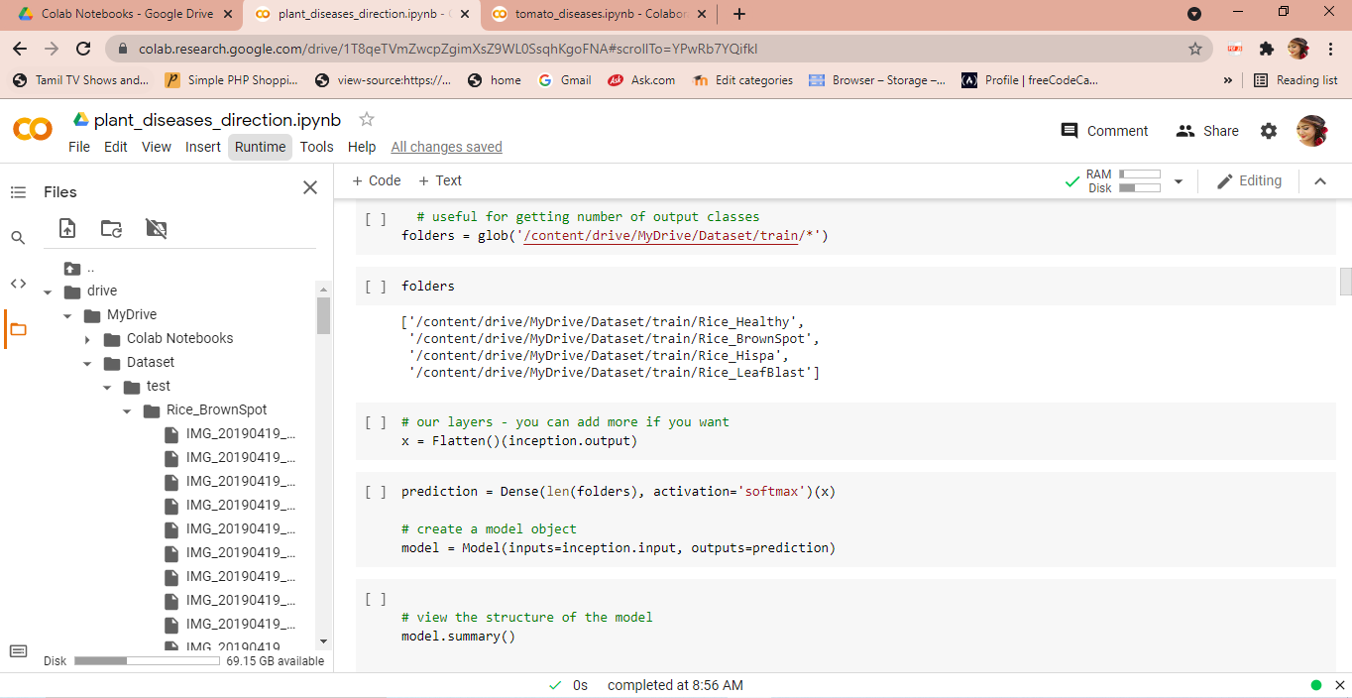
IT18181784 | S. LATHUSHA | 2021-135
28/04/2021

Slide 39
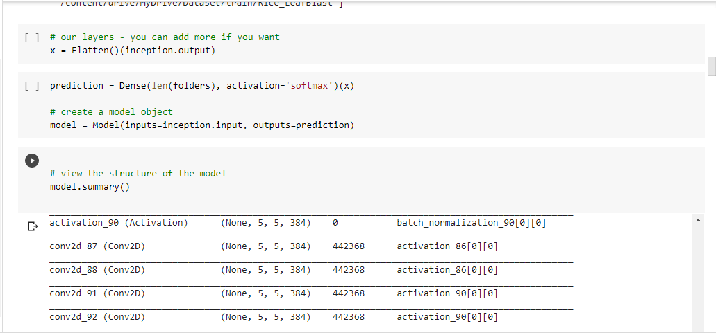
IT18181784 | S. LATHUSHA | 2021-135
28/04/2021

Slide 40
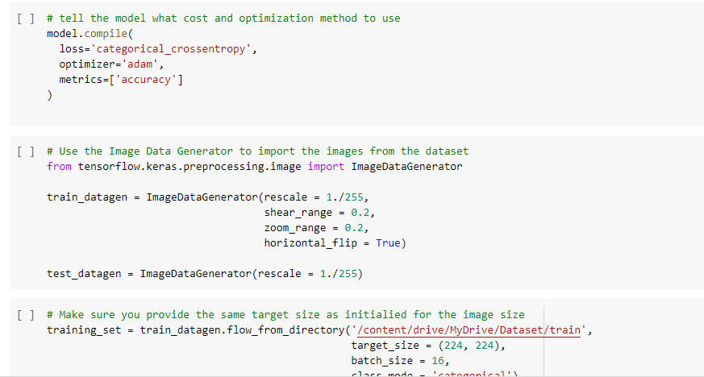
IT18181784 | S. LATHUSHA | 2021-135
28/04/2021

Slide 41
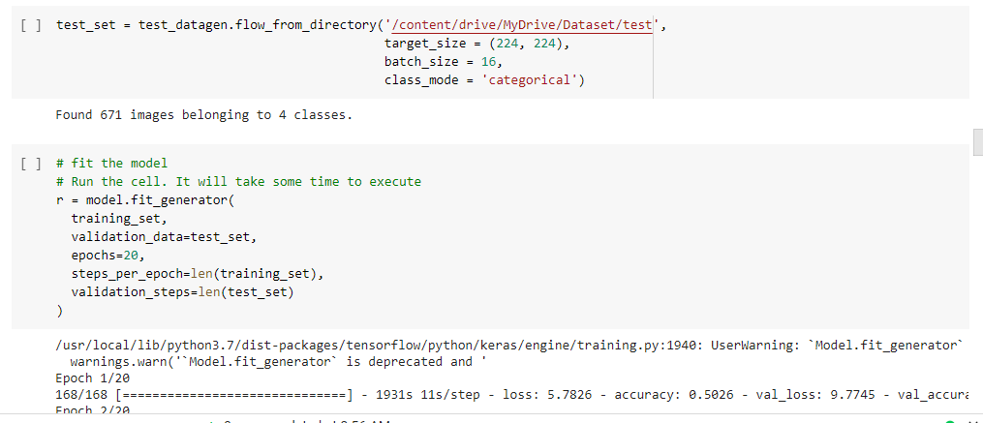
IT18181784 | S. LATHUSHA | 2021-135
28/04/2021

Slide 42
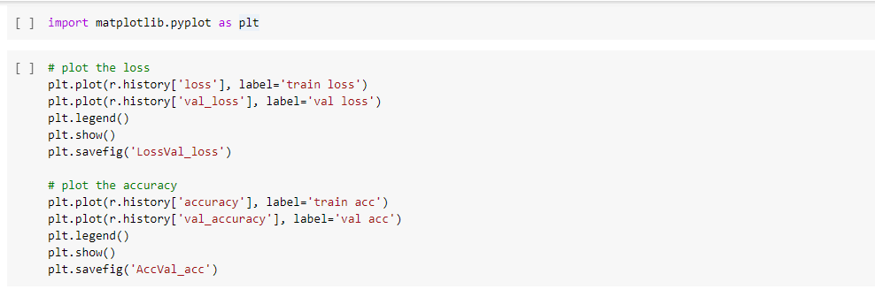
IT18181784 | S. LATHUSHA | 2021-135
28/04/2021

Slide 43
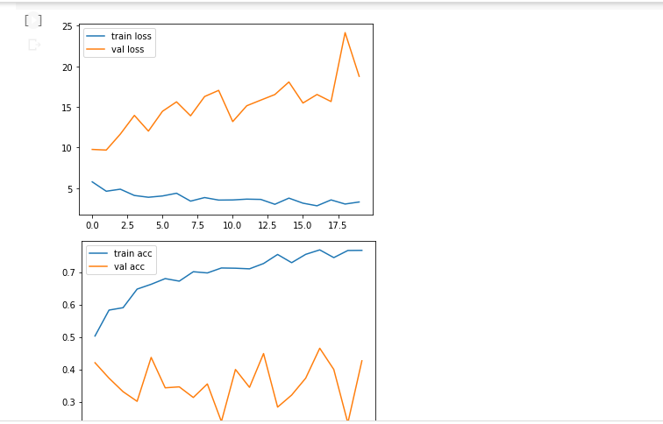
Accuracy matrix
IT18181784 | S. LATHUSHA | 2021-135
28/04/2021

Slide 44
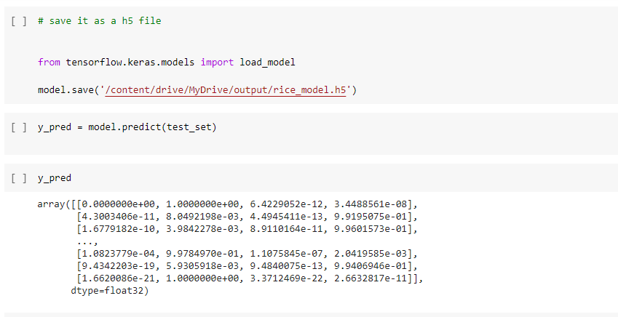
Save the model

Slide 45
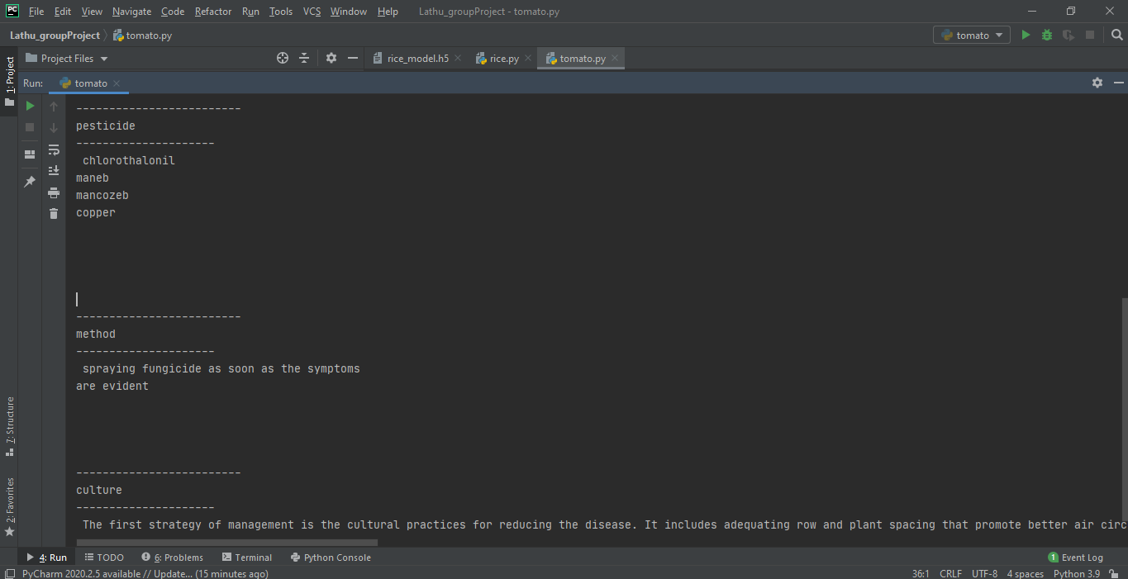
Method for detecting rice diseases using trained data

Slide 46
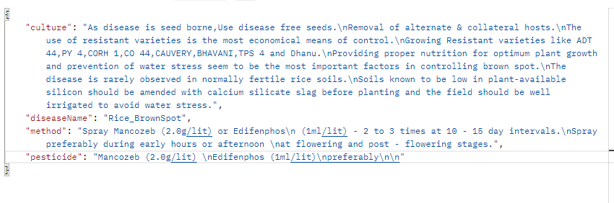
Method for detecting rice diseases using trained data

Slide 47
Method for detecting rice diseases using trained data
Backend Technologies
Python
pyCharm
cnn algorithm
Tensorflow, keras libraries
Artificial Intelligent(ML, DL)
Google cloud
Frontend Technologies
Android Studio
Java

Slide 48
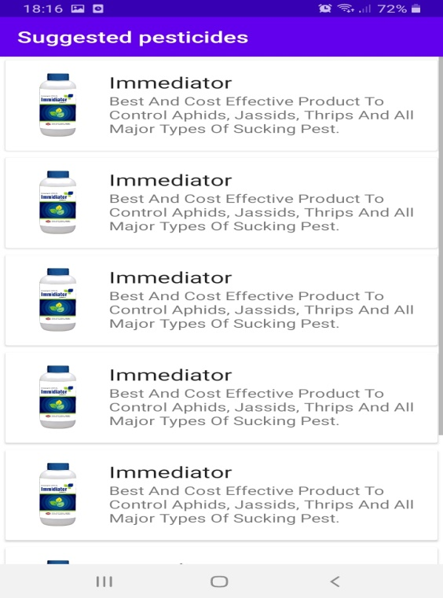

Slide 49
Achievements and Individual Progress
Analyzed the requirements & Dataset.
Check Key Pillars and Technology Feasibility.
Planning the Method for the plant diseases Analysis.
Collect images for different types of diseases in plant.
Design and Develop the Analysis Model.
Train the Model Using Dataset.
Get most accurate result using test data

Slide 50
Implement a method to give pesticide and management suggestion for every diseases .
Develop user friendly interface to find diseases by images and suggest pesticide and management
Develop a method to find diseases and suggest pesticide in mobile App using past trained dataset
Improve this modal to get most accurate result

Slide 51
IT18179118 Keeyani Sivagnanam
B.Sc (Hons) in IT
IT18179118 | S.Keeyani | 2021-135
14/10/2021

Slide 52
Research Questions
Farmers unable to expand their marketing. They can cover a small area. What is the basic problem?
How do you choose a user-friendly platform for farmers?
What are the outputs farmers are expecting?
How to use vegetables name with different language people while marketing?
IT18179118 | S.Keeyani | 2021-135
28/04/2021

Slide 53
Research Gap
Sometimes they have an idea about a product and do not know the particular area people using vegetable names.
Product suggesting options for farming e-commerce platforms are very rare.
IT18179118 | S.Keeyani | 2021-135
28/04/2021

Slide 54
Objectives
Specific Objective
Sub Objectives
This will provide good guidance for farmers and system will suggest the vegetable name.
System will correct the user words and provide correct output.
To answer questions accordingly configure the appropriate classification algorithm.
Cleaning the dataset and creating a frequent data dictionary.
Providing three languages output in English characters.
IT18179118 | S.Keeyani | 2021-135
28/04/2021

Slide 55

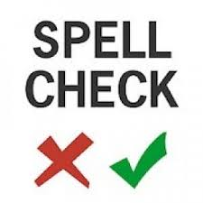


Methodology
Input data
Suggesting output
IT18179118 | S.Keeyani | 2021-135
28/04/2021

Slide 56




TECHNOLOGIES
28/04/2021

Slide 57
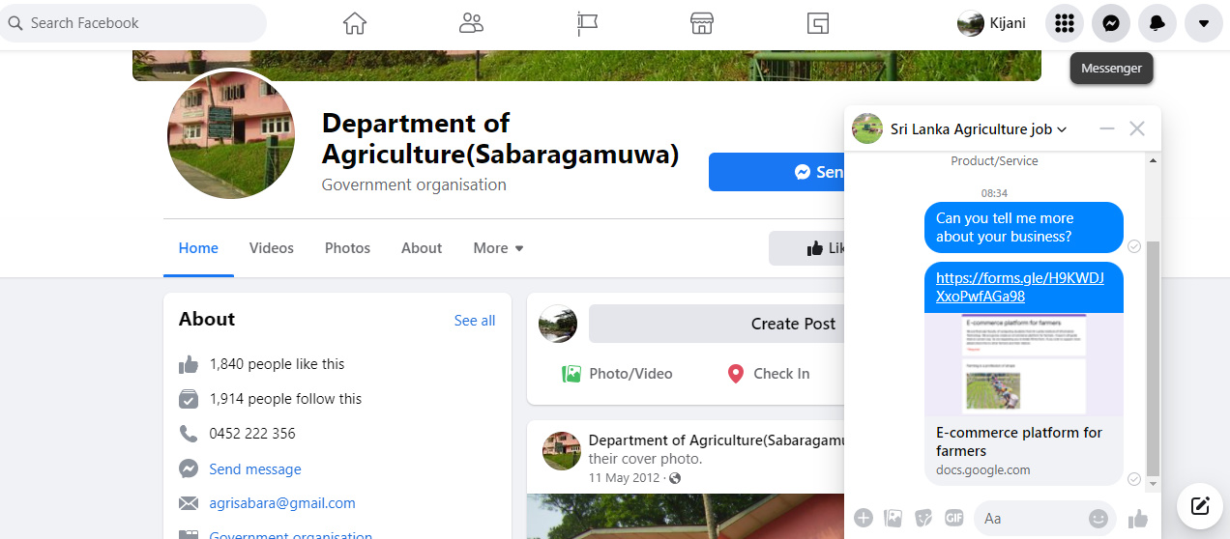
Data collection
IT18179118 | S.Keeyani | 2021-135
28/04/2021

Slide 58
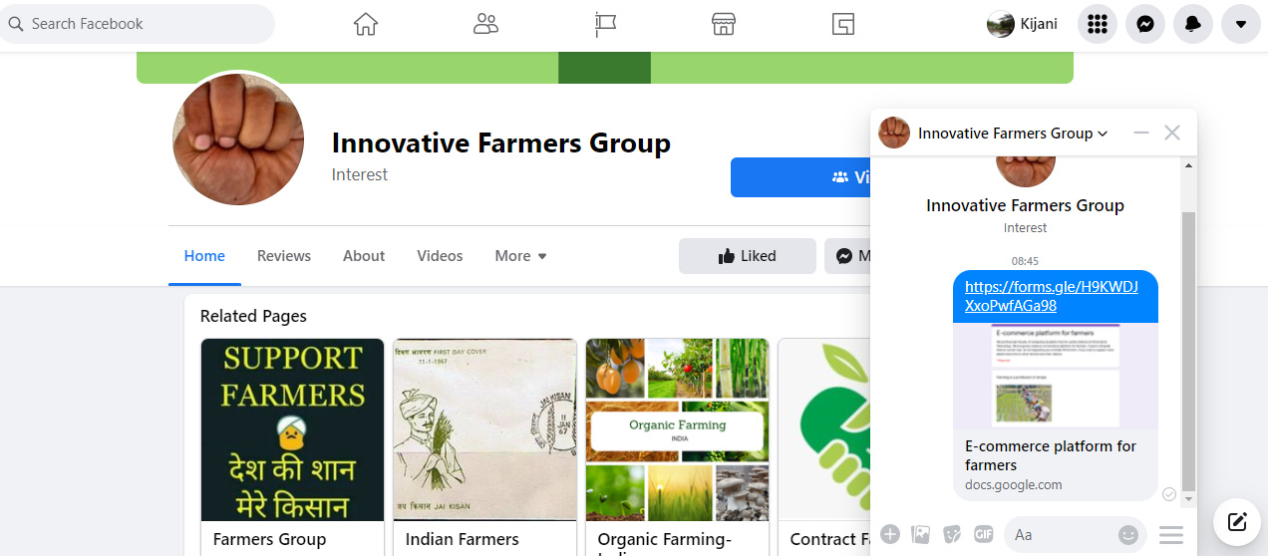
Data collection
IT18179118 | S.Keeyani | 2021-135
28/04/2021

Slide 59
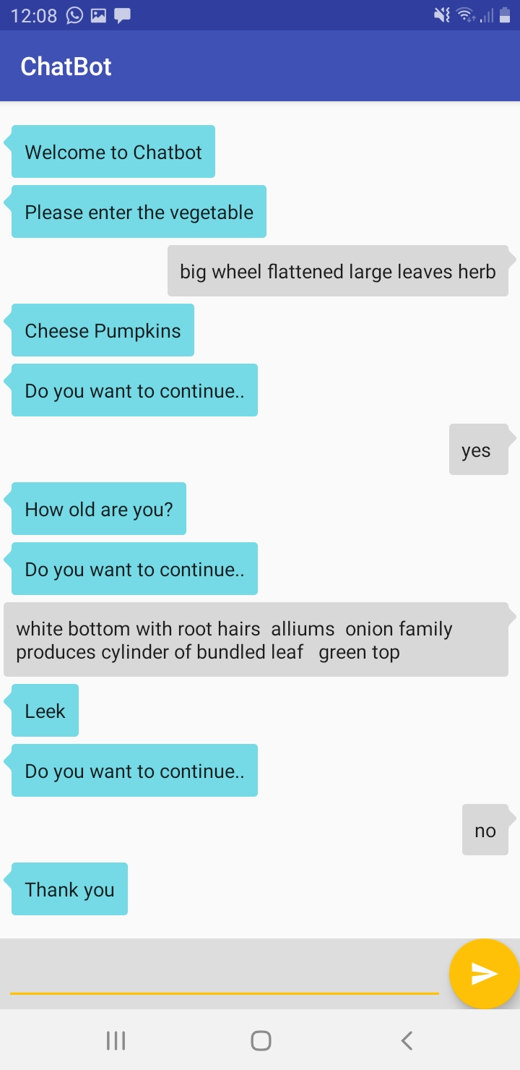
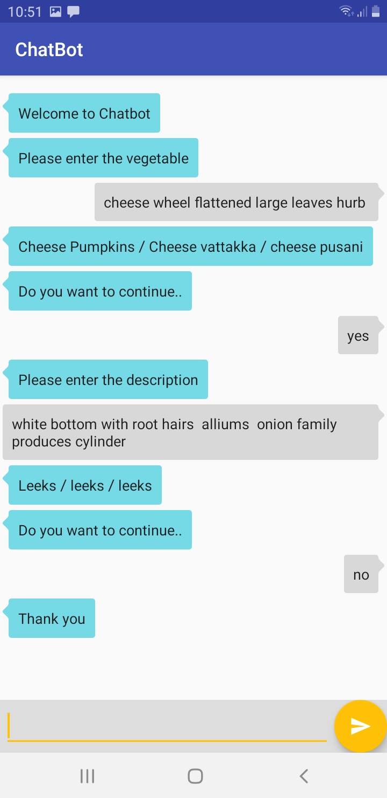
Testing and Results
After user experience gathering
IT18179118 | S.Keeyani | 2021-135
28/04/2021

Slide 60
THANK YOU!! Q & A

